Slide 1
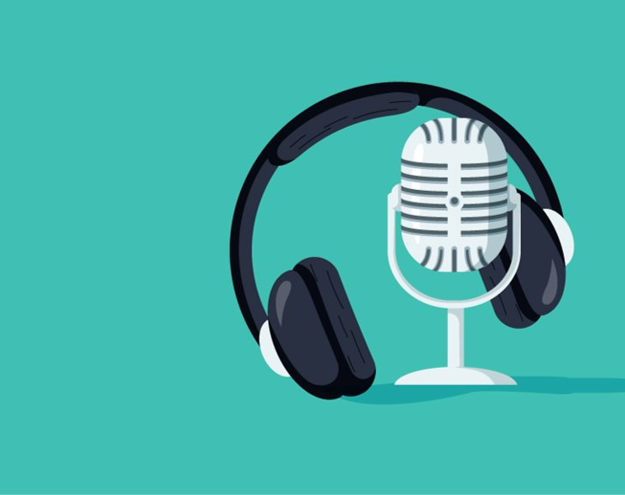
Podcasts and Podcasting

Slide 2
ING-3 (Second Semester)
Can I plan my own podcast?
Let's recap what a podcast is and the features

Slide 3
Definition
A podcast is a digital audio program, often part of a series, available for on-demand streaming or download over the internet. Typically episodic, it functions like on-demand talk radio, covering specific topics or themes. While primarily audio, many modern podcasts also include video components on platforms like YouTube.
The term podcast is a portmanteau (a combination of words) of "iPod" and "broadcasting" (or broadcast). Coined in early February 2004 by journalist Ben Hammersley, the term was created to describe the rising trend of amateur, RSS-fed audio content that users could download and listen to on portable media players, particularly Apple's iPod.

Slide 4
Lesson 2
LC: Can I plan my own podcast?
Recap
An audio programme downloaded from the internet
Can be listened to anytime and anywhere on a tablet/phone/computer using earphones/headphones/speakers
The podcast is a series of programmes with individual podcast episodes within that series
Vary in length from a few minutes to a couple of hours
Daily/weekly/monthly, some run indefinitely
Wide range of topics

Slide 5
Lesson 2
LC: Can I plan my own podcast?
Once a podcast has been recorded, the producer sends the sound files to a podcast hosting site along with a bit of information about the podcast to help publicise it
Other people can then download the podcast to their own device and listen to it

Slide 6
This term you are going to plan a podcast episode of your own, thinking about the features you have just revisited

Slide 7
What is your overall topic/theme?
This can be something quite broad with individual episodes being more specific
Needs to be something that you can talk about in depth, something that really interests you
Title/name of your podcast series
Catchy
Not very long
Use alliteration
Use a pun( a wordplay that exploits multiple meanings of a term generally used to create wit, irony or comedy…)
Who is your target audience?
Who do you want to listen to your podcast?
Specific groups of people?
Age range?

Slide 8
How many episodes will your podcast series have? What are your individual episodes going to be about?
You need to have enough episodes to cover your topic and keep your listener interested, perhaps 4, 5 or 6 to start with
Each episode needs to have its own title, a bit like a subheading
What will be the main content of each episode?
How long will each episode last?
The episodes need to be long enough for you to get your info/message across but short enough that listeners don’t get bored and switch off
You’ve got to be able to fill the time

Slide 9
Have you got some introduction music? Can you think of a jingle or a slogan?
Podcasts often start with some music or a jingle. In real life, you would have to check the permissions to use other people’s music.
A jingle is a bit like a logo. It’s a short burst of music/song that can be identified as being your podcast. Lots of famous brands have a jingle which is instantly recognisable without us even seeing the logo or product eg MacDonalds
Design a logo
This is a symbol/picture that people will instantly recognise as being your podcast
Something quite simple but eye catching
Something related to your topic

Slide 10
Lesson 2
LC: Can I plan my own podcast?
Who would you like to interview/contribute to your different episodes?
Depending on what you’re talking about, you might want to invite people on to your show; friends, family, celebrities
It might be someone who has the same passion for your topic as you do or you might want to interview someone famous
You might invite people for a couple of episodes or you might interview someone new every time
Will you be presenting on your own or with others?
Would you want to present on your own and invite different people to join you?
Would you want to present with someone else? A friend or family member?

Slide 11
ANY QUESTIONS?

Slide 12


